Slide 1
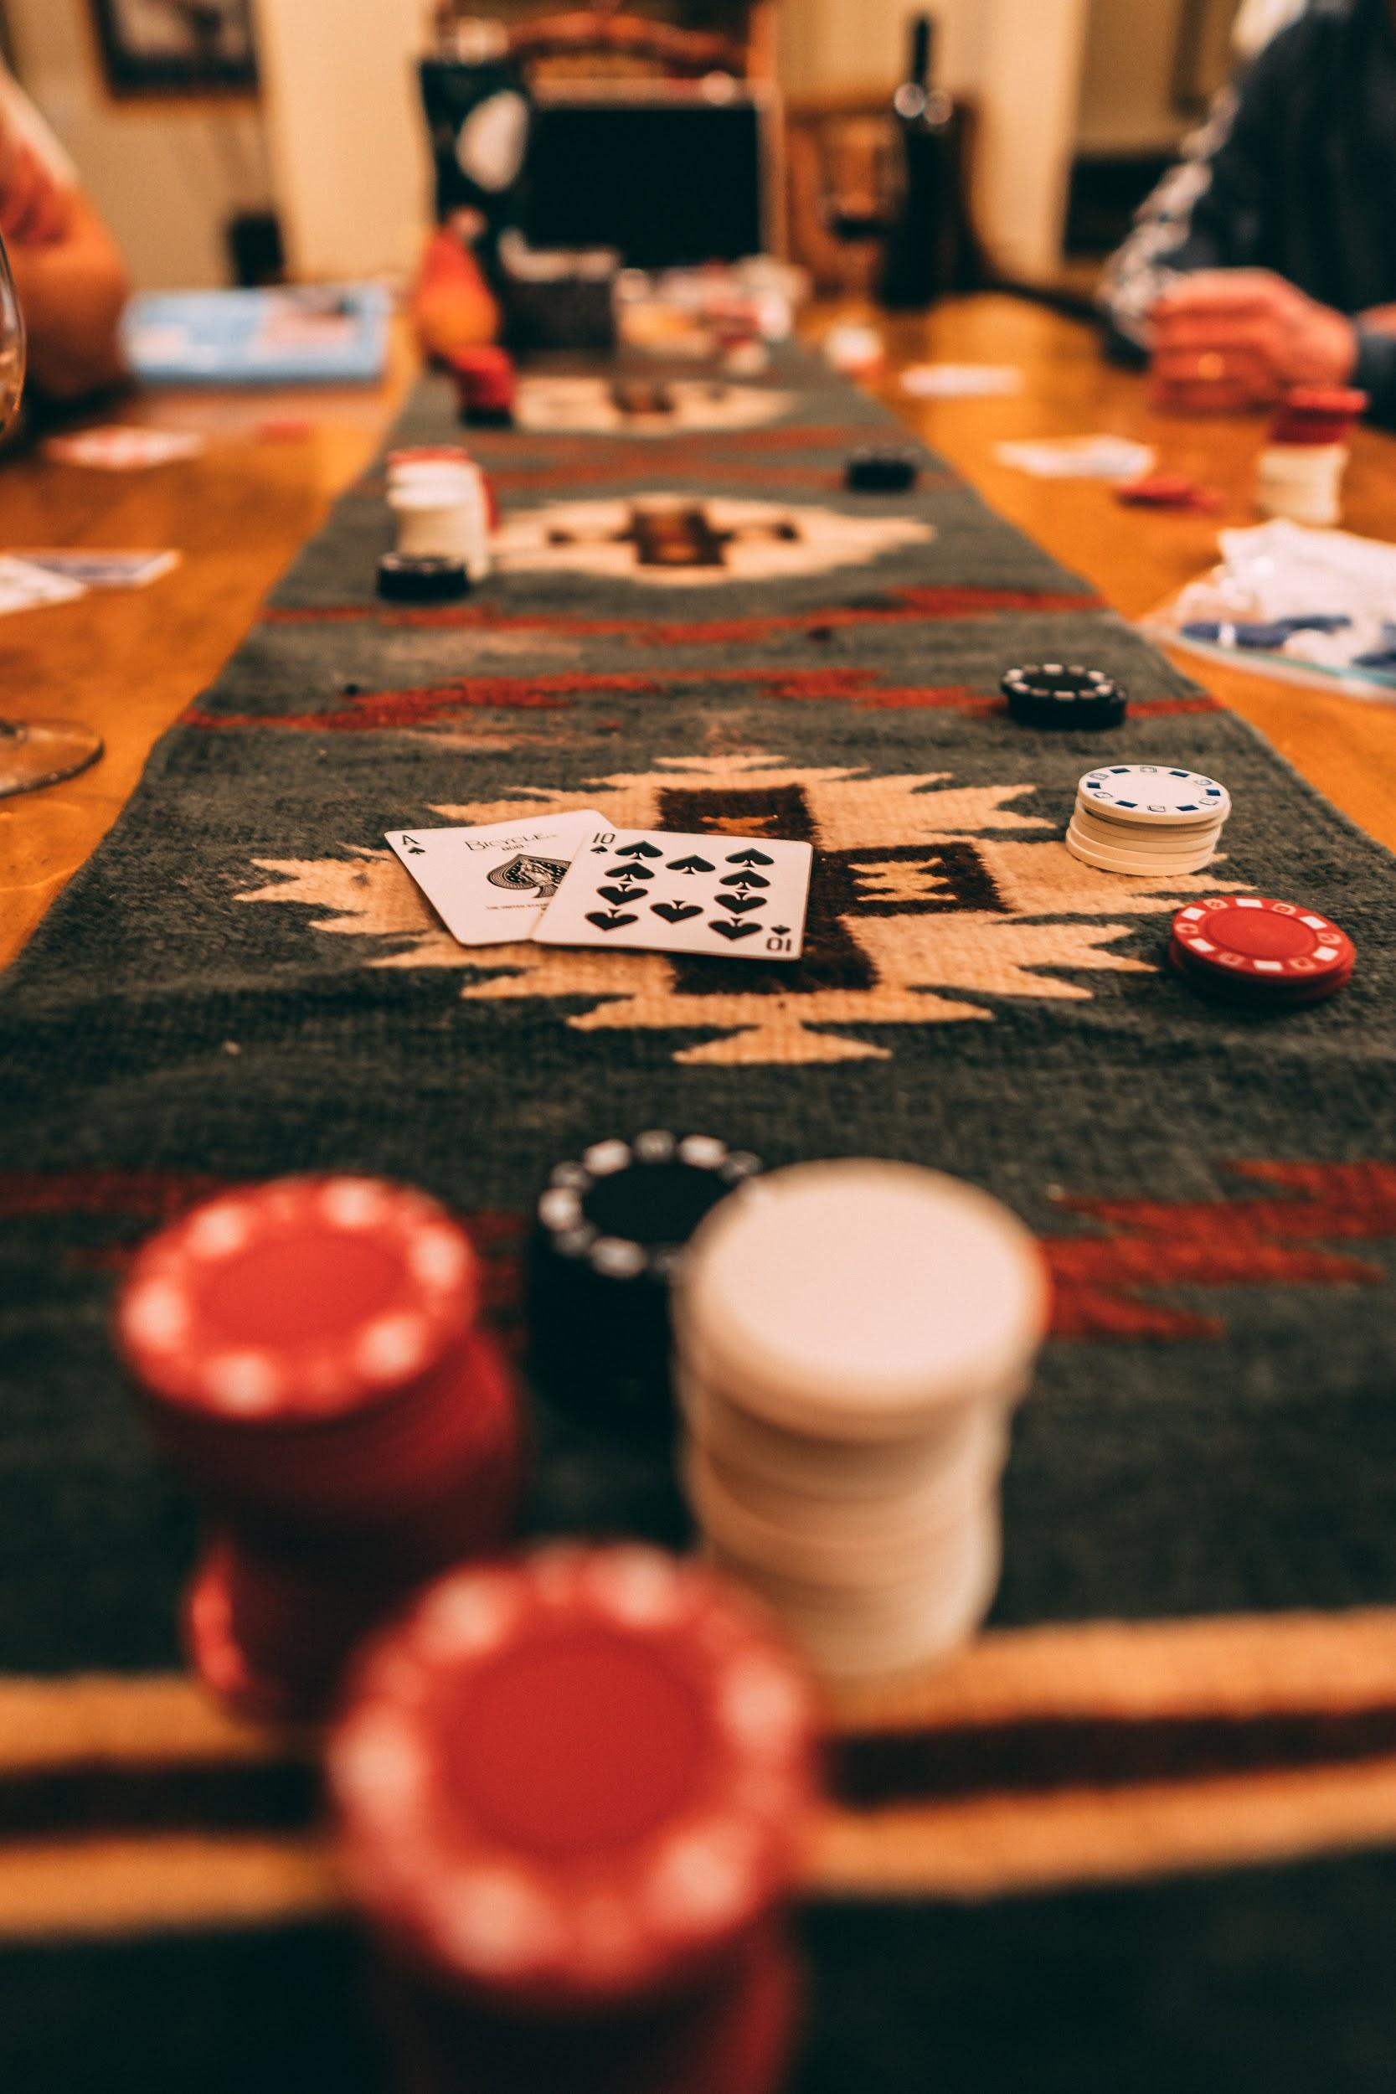

BLACKJACK
Winner winner chicken dinner !
by Leonardo Cavalcante Araujo
Notes:
Title of the project + Student name
Description of your game
Challenges
Process
Learnings
If I were to start from scratch...
Improvements
Highlights
Demo (ONE MINUTE)

Slide 2
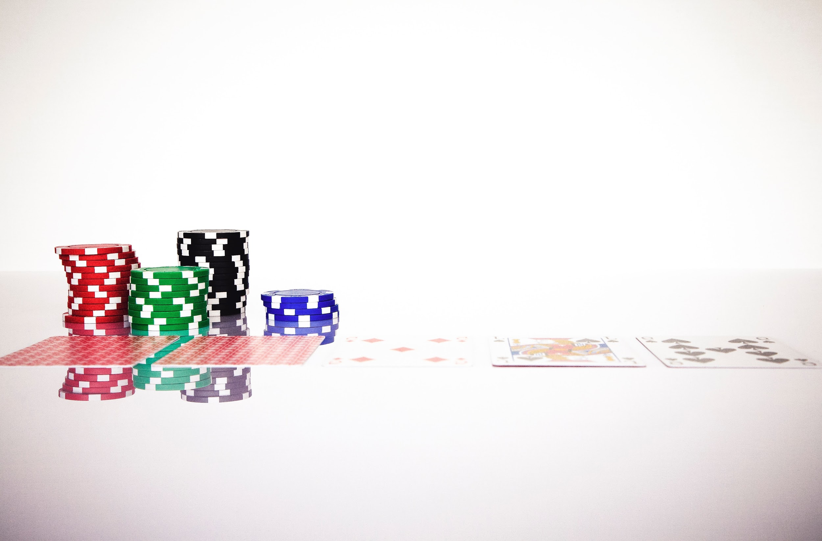
GAME DESCRIPTION
01

Slide 3



01
GAME DESCRIPTION (1/2)
---- RULES ----
21
Casino game played with 1 to 8 deck of cards.
Usually involves money through Bets.
Points attributed to players and counted as follow :
Cards 2 to 10: correspond to their numerical values
Face Cards (J, Q, K): counts as 10 points
Ace: either 1 or 11 points, which is decided by the one who draws this card.
Is the best punctuation for the player’s hand.
Beyond this limit, the player loses.

Slide 4
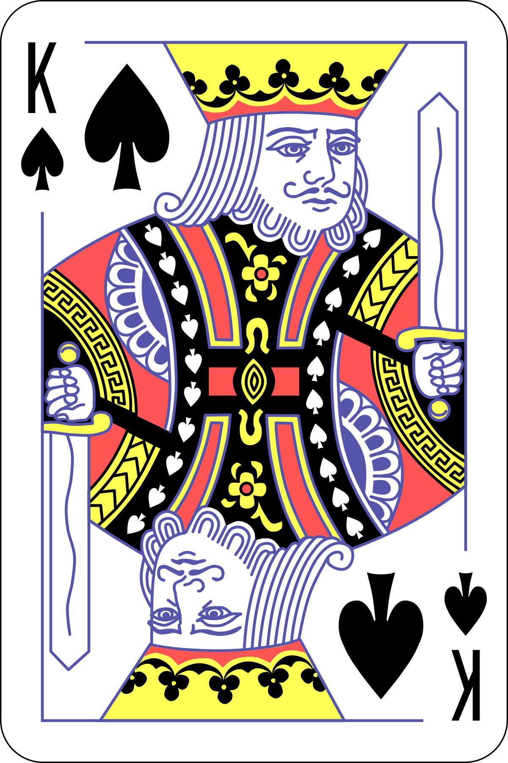


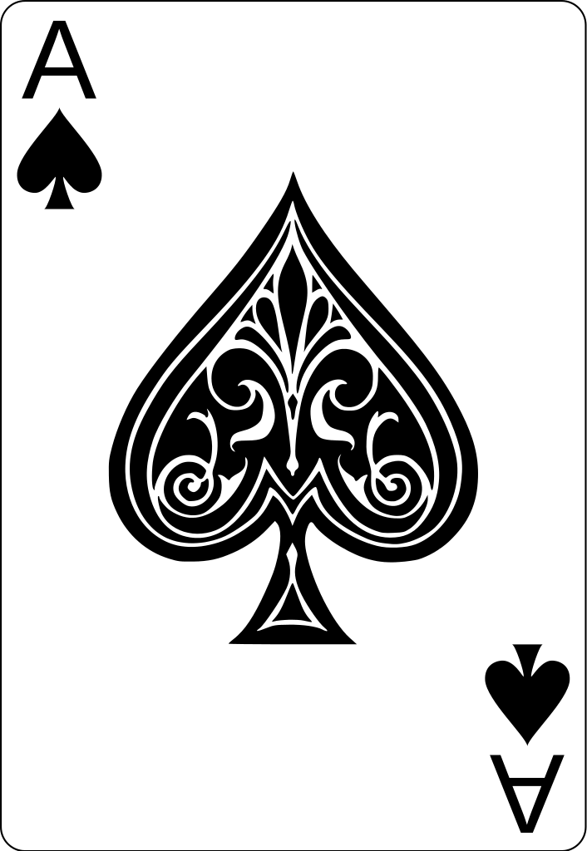


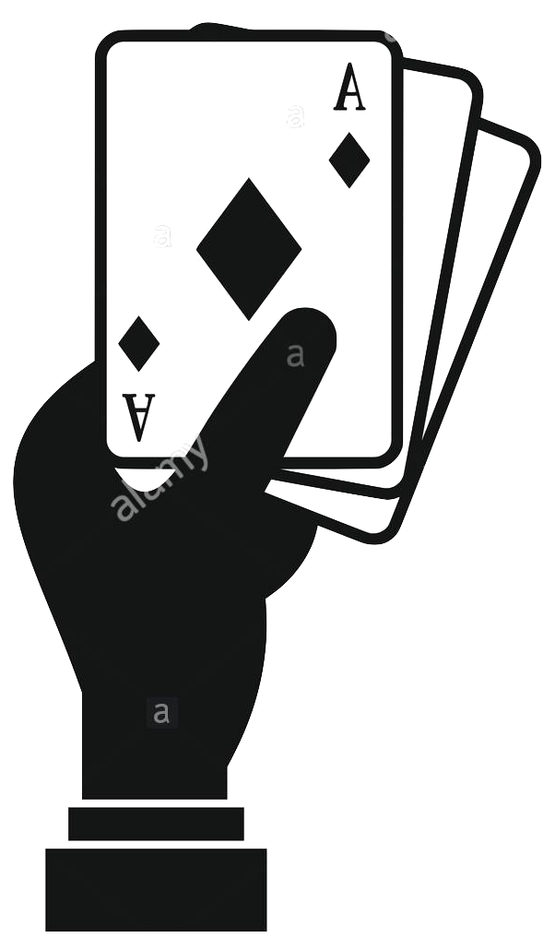
01
GAME DESCRIPTION (2/2)
---- PLAYER ----
---- DEALER ----
Player place the bets
Pre-
round
CPU follow the bet
Automatically draw 2 cards to player
Turn 1
Only draw 1 card and wait
Player can choose until he is satisfied
Turn 2
and beyond
When player is finished drawing cards and if player score <=21, CPU draw the rest of its cards.
The winner cashes the pot of money of all bets of the round

Slide 5
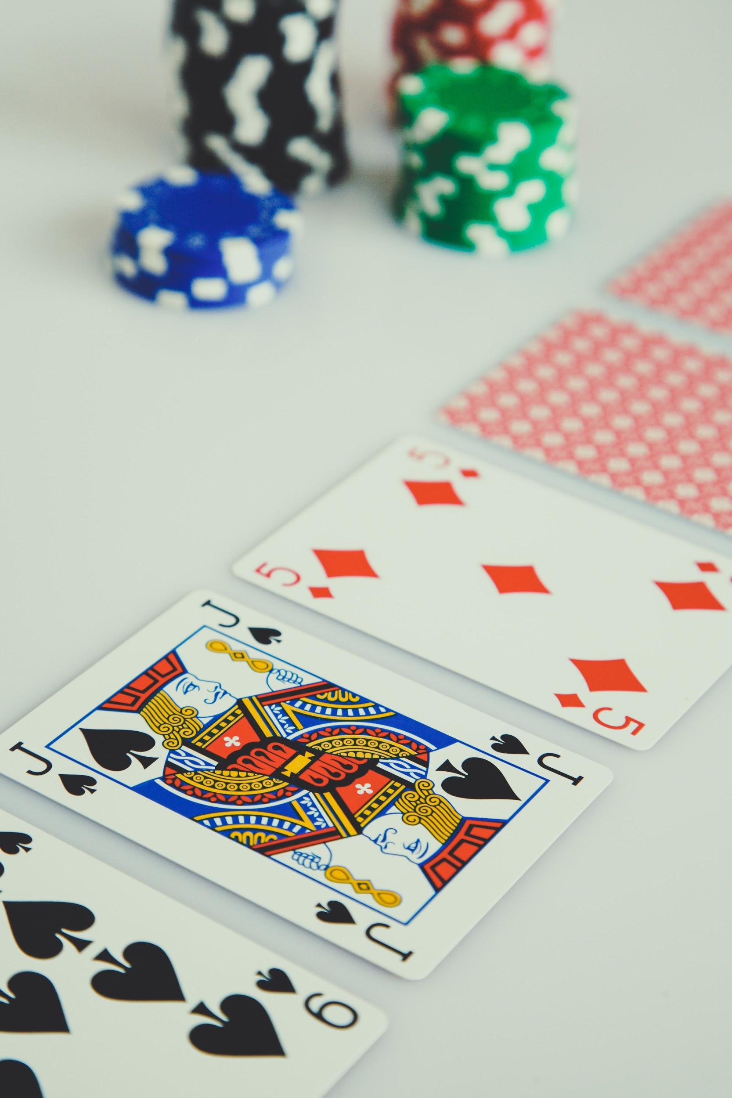
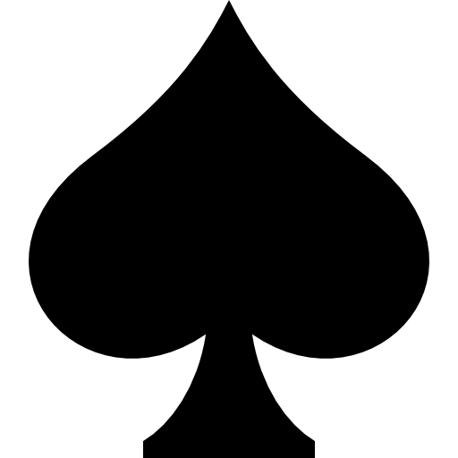
PROCESS,
CHALLENGES AND LEARNINGS
02

Slide 6

PROCESS, CHALLENGES AND LEARNINGS
02
1
2
4
3
ITERATIONS
Global Variables
Functions
Definition and resetting
Definition and creation
Visuals and GUI interface
Main code
Prints the screens for the player
for execution of the game

Slide 7
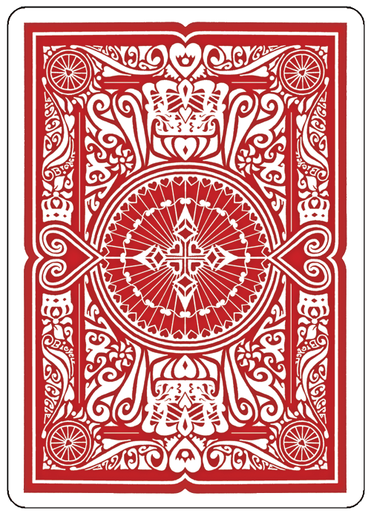
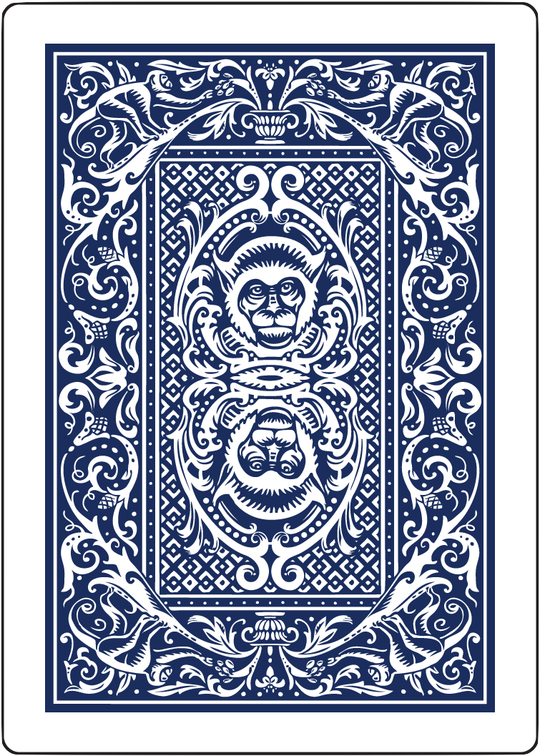
CHALLENGES
LEARNINGS
Working with visual elements in Python.
Structuring my codes and optimizing it using :
More functions
and less variables
Classes in Python are still not very familiar to me.
Preparation, planning and organization is key to achieve excellent results in the given deadline.
Learn by doing and test and learn are very efficient forms to acquire results as well.
Python libraries can be of good help.

Slide 8
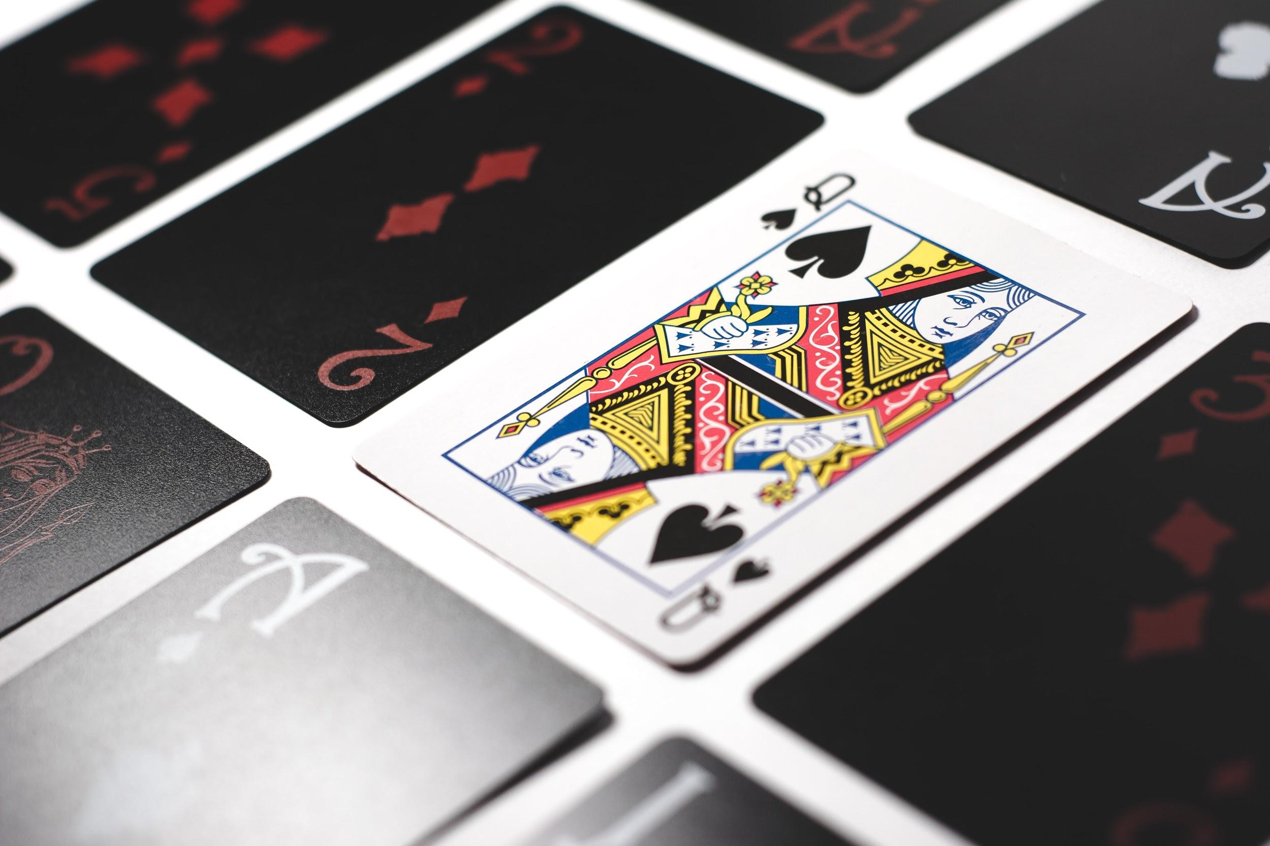
02
START FROM SCRATCH
IMPROVEMENTS
HIGHLIGHTS

Slide 9

If I were to start from scratch...
If I were to start from scratch...
Improvements and highlights
Improvements and highlights
I would spend some more time in preparation through:
Listing the functions before implementing.
I would think first: about the possibility of creating a class and about searching helpful libraries online.
Clean all variables and use the function more wisely with global variables and maybe with a class
Deploy some more rules : multi-players, doubling down and splitting
Develop further the GUI interface with tkinter

Slide 10

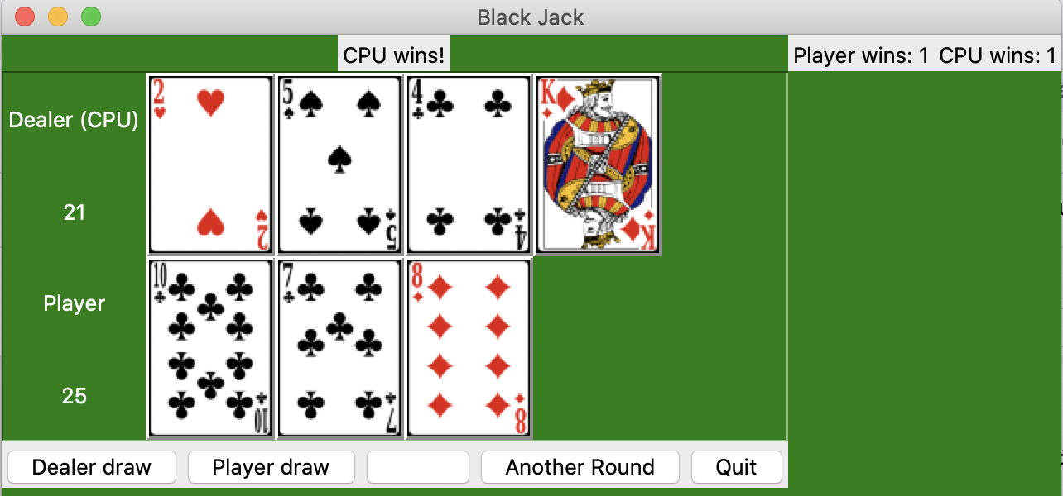
Highlights
Highlights

Slide 11
DEMO TIME
Winner winner chicken dinner !
by Leonardo Cavalcante Araujo
Notes:
Title of the project + Student name
Description of your game
Challenges
Process
Learnings
If I were to start from scratch...
Improvements
Highlights
Demo (ONE MINUTE)

